Slide 1
IDC 606 HPC Presentation
-Gourab Koley

Slide 2
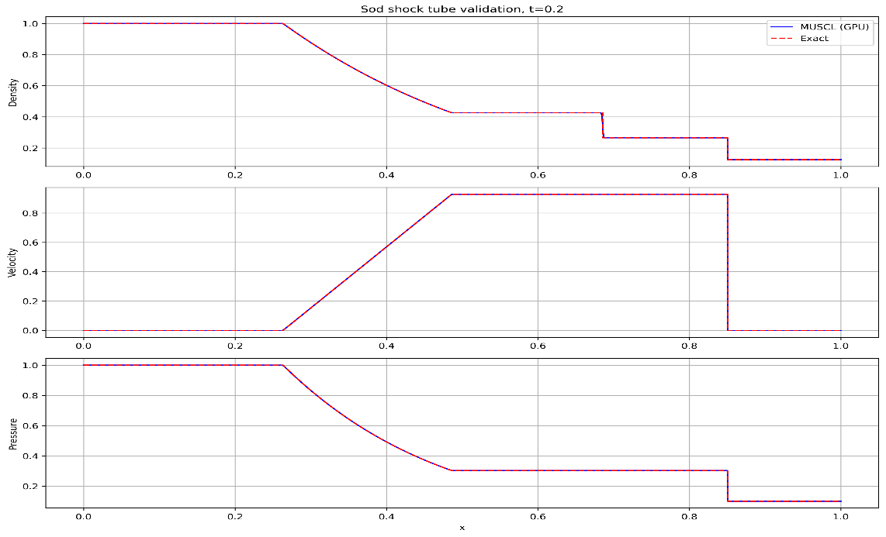
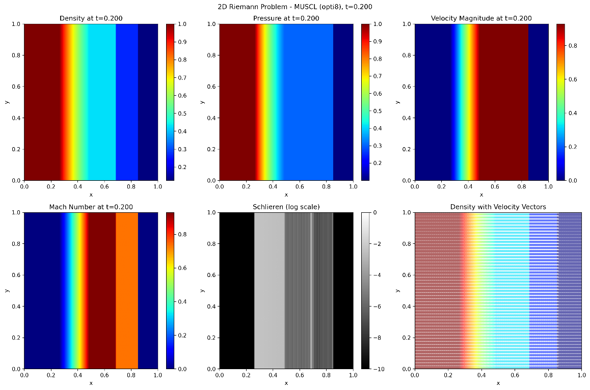
Validation and Verification
L1 errors at t = 0.2 :
Density: 0.000174 Velocity: 0.000187 Pressure: 0.000075

Slide 3
Comparison chart of CPU and GPU

Slide 4
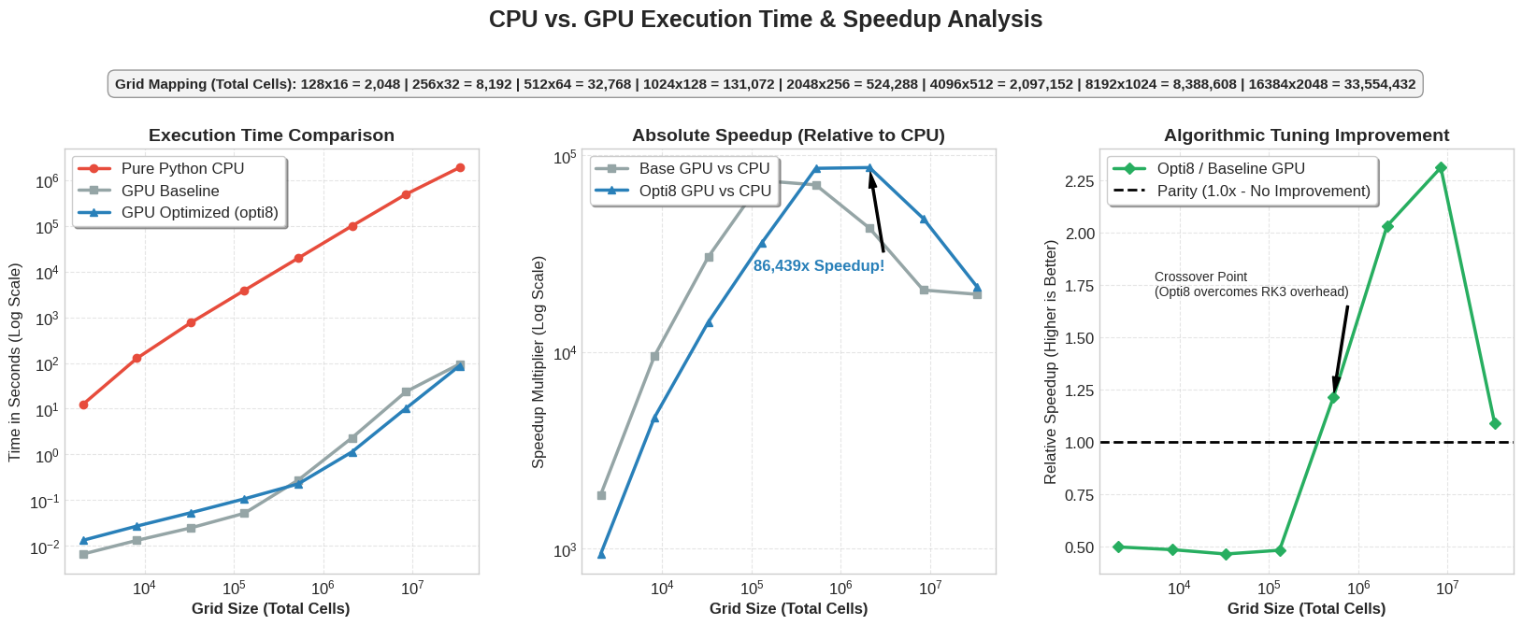
Speed up for CPU vs GPU

Slide 5
Specs of different versions of GPU optimized codes

Slide 6
Specs of different versions of GPU optimized codes
Fuses the RHS calculation with the Runge-Kutta time-stepping kernels to reduce global memory roundtrips.
Fuses the RHS calculation with the Runge-Kutta time-stepping kernels to reduce global memory roundtrips.
Baseline
Unoptimized baseline implementation using isolated kernels and an Array of Structures (AoS) memory layout.
Opti_1
Reduces computational overhead by eliminating expensive division operations
Opti_2
Explores primitive variable passing to reduce redundant state conversions
Opti_3
Fuses the RHS calculation with the Runge-Kutta time-stepping kernels to reduce global memory roundtrips.
Opti_4
Eliminates intermediate flux arrays by computing the entire spatial operator locally within GPU registers.

Slide 7
Specs of different versions of GPU optimized codes
Fuses the RHS calculation with the Runge-Kutta time-stepping kernels to reduce global memory roundtrips.
Fuses the RHS calculation with the Runge-Kutta time-stepping kernels to reduce global memory roundtrips.
Opti_5
Extends the extreme fusion architecture to support a robust 3-stage SSP-RK3 scheme.
Opti_6
Refactors the data architecture from Array of Structures (AoS) to Structure of Arrays (SoA).
Opti_7
Optimizes thread block dimensions and local stencil loading to prevent register spilling.
Opti_8
Pushes grid spacing calculations to constants to squeeze out final floating-point efficiencies.
Opti_8_shmem
Leverages ultra-fast on-chip GPU shared memory to cache overlapping cell data.

Slide 8
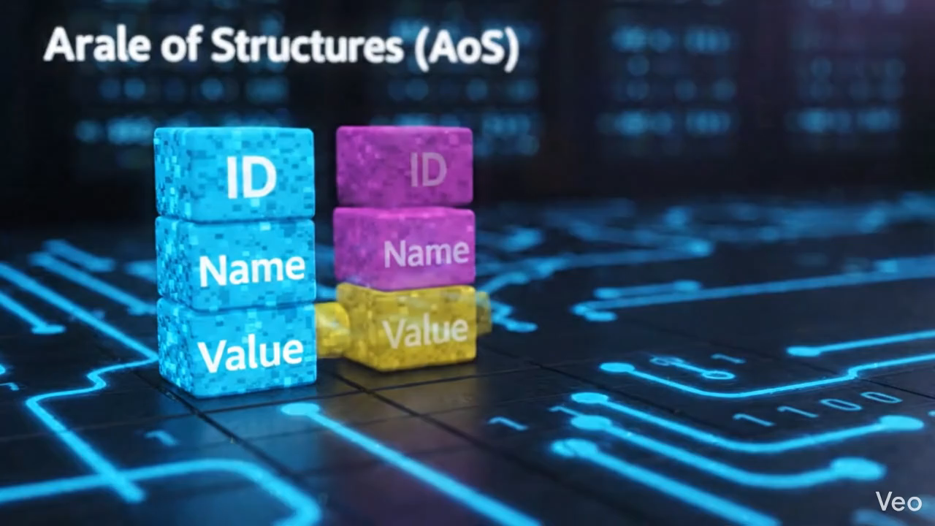
AoS and SoA Architecture

Slide 9
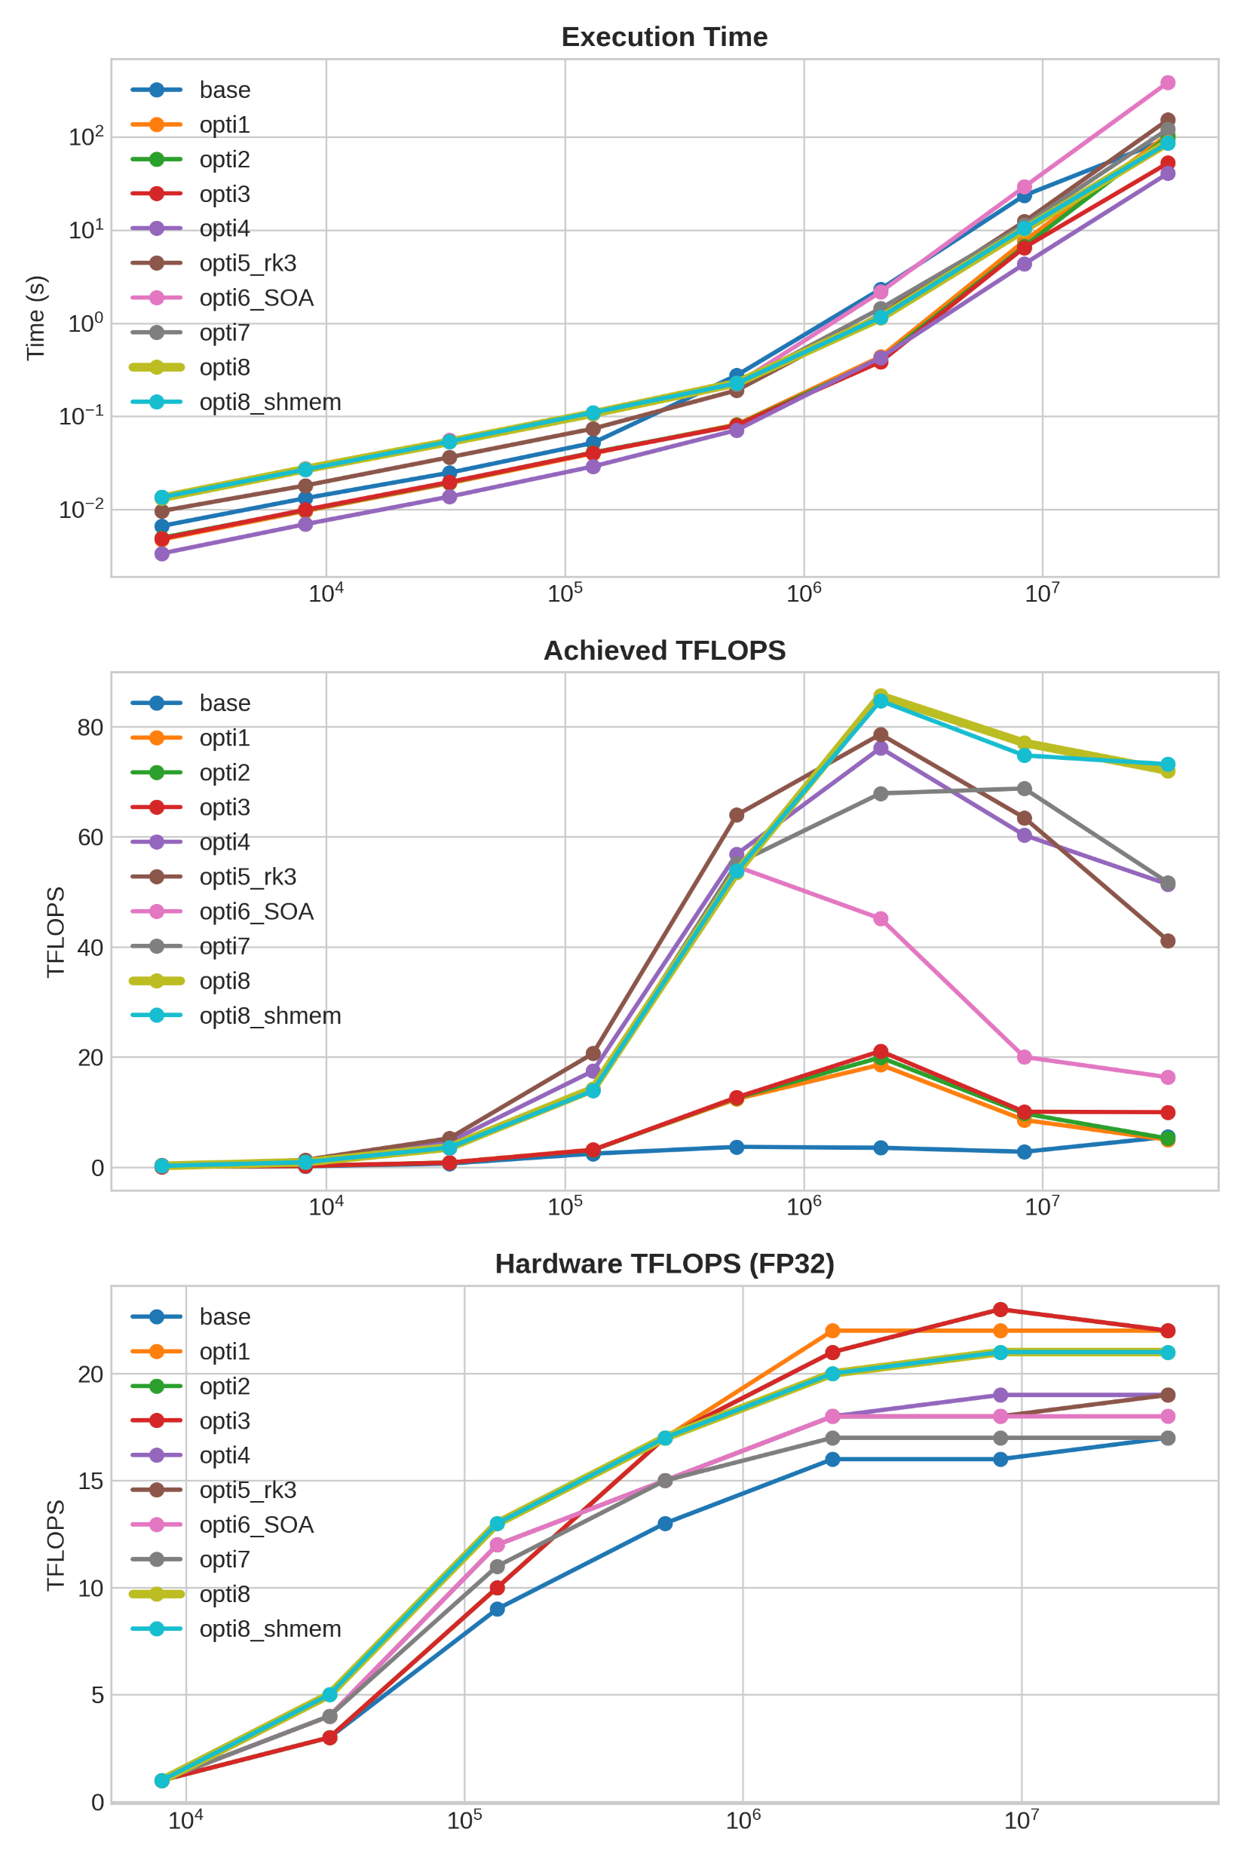
Performance Scaling

Slide 10
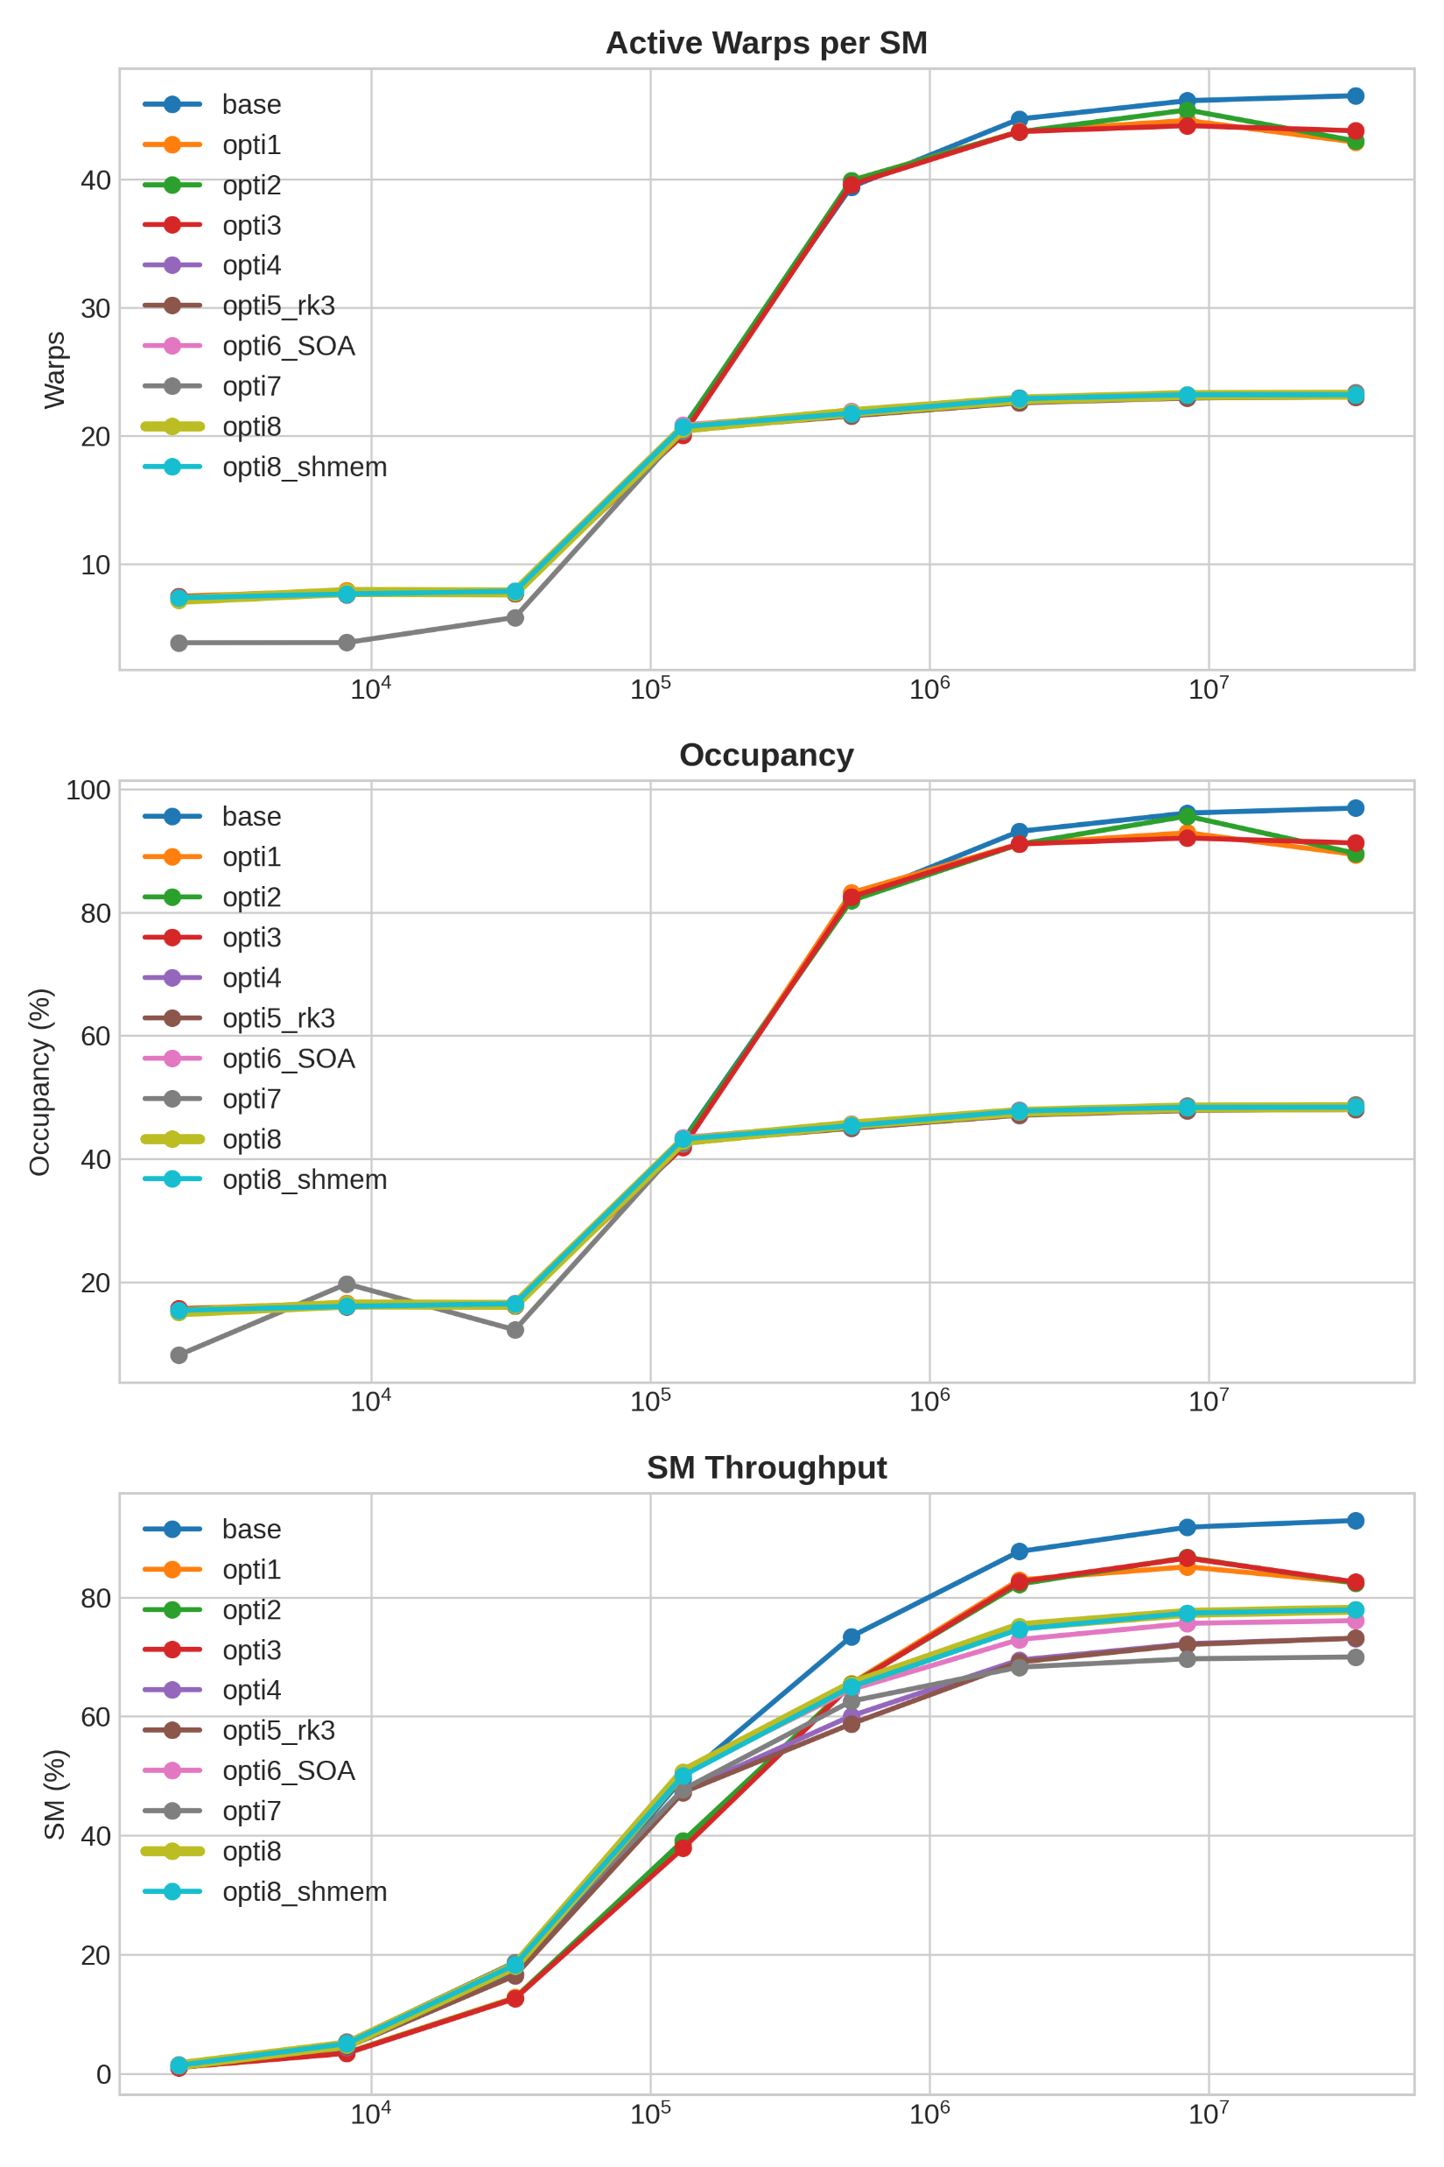
GPU Utilization

Slide 11
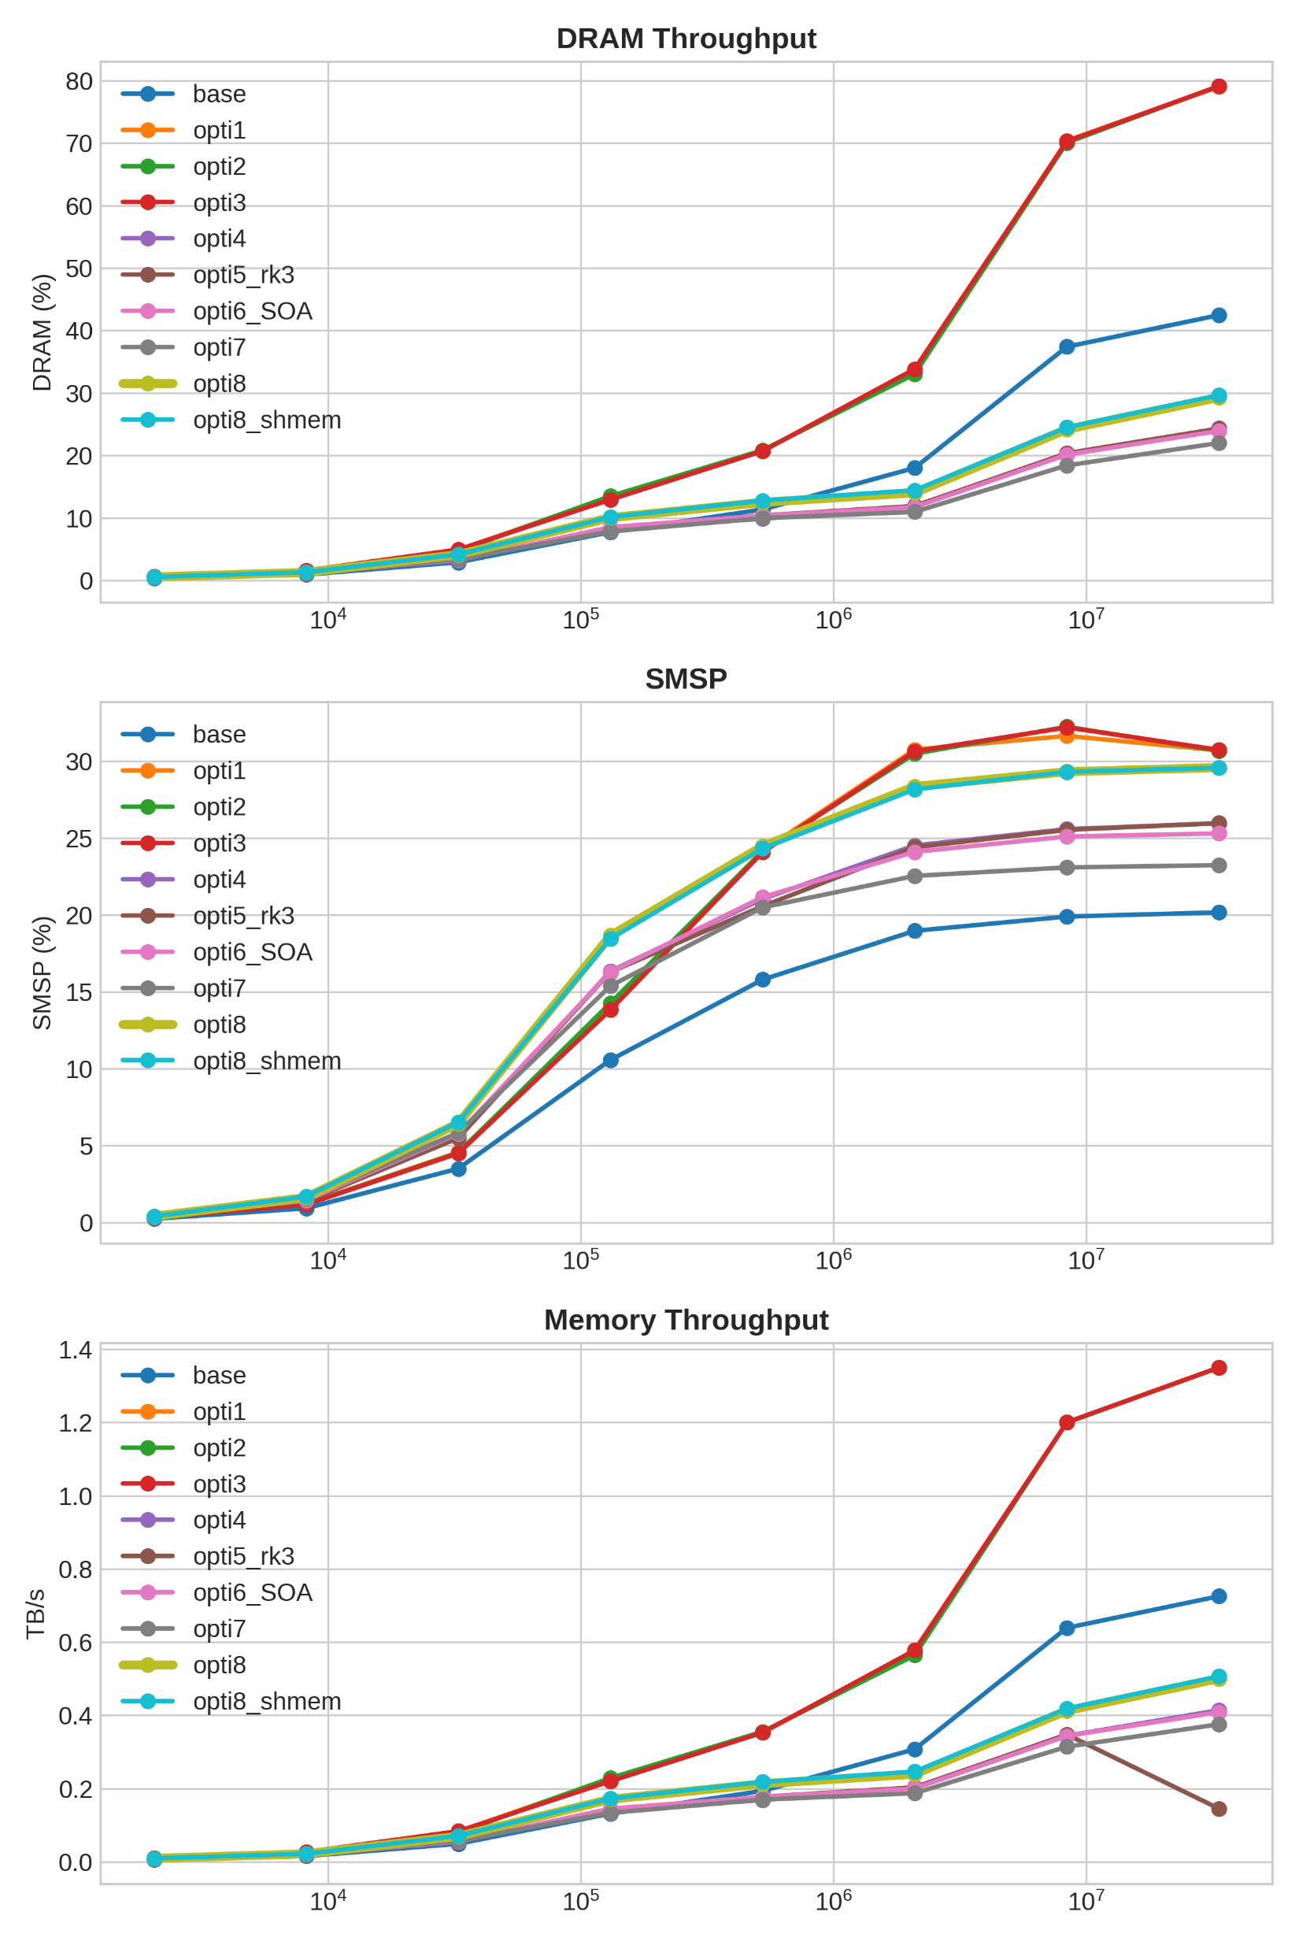
Memory Behaviour

Slide 12
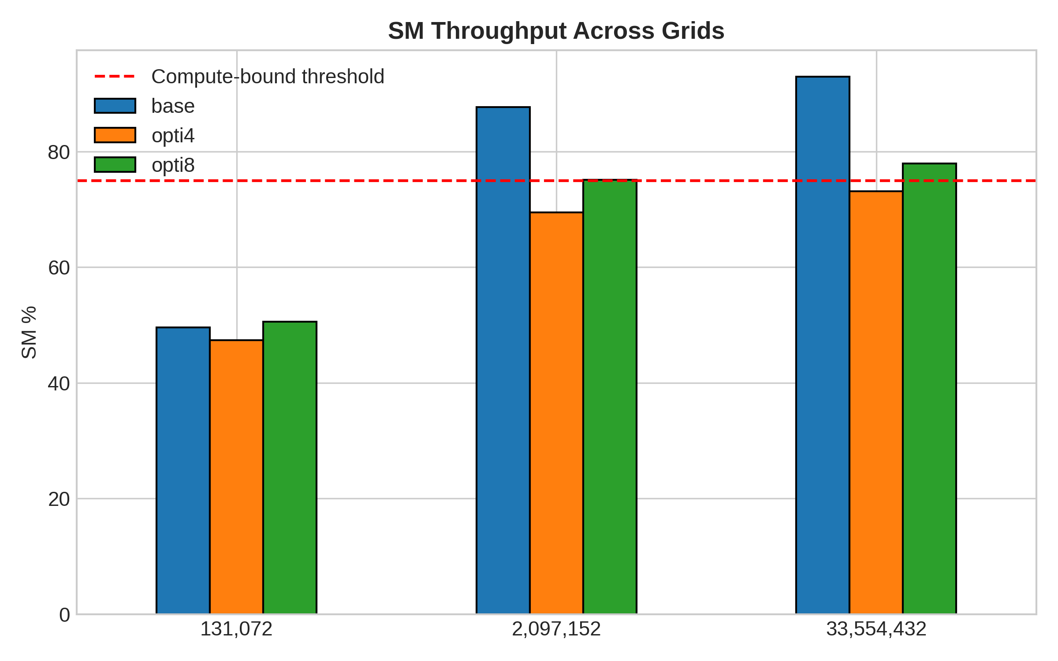
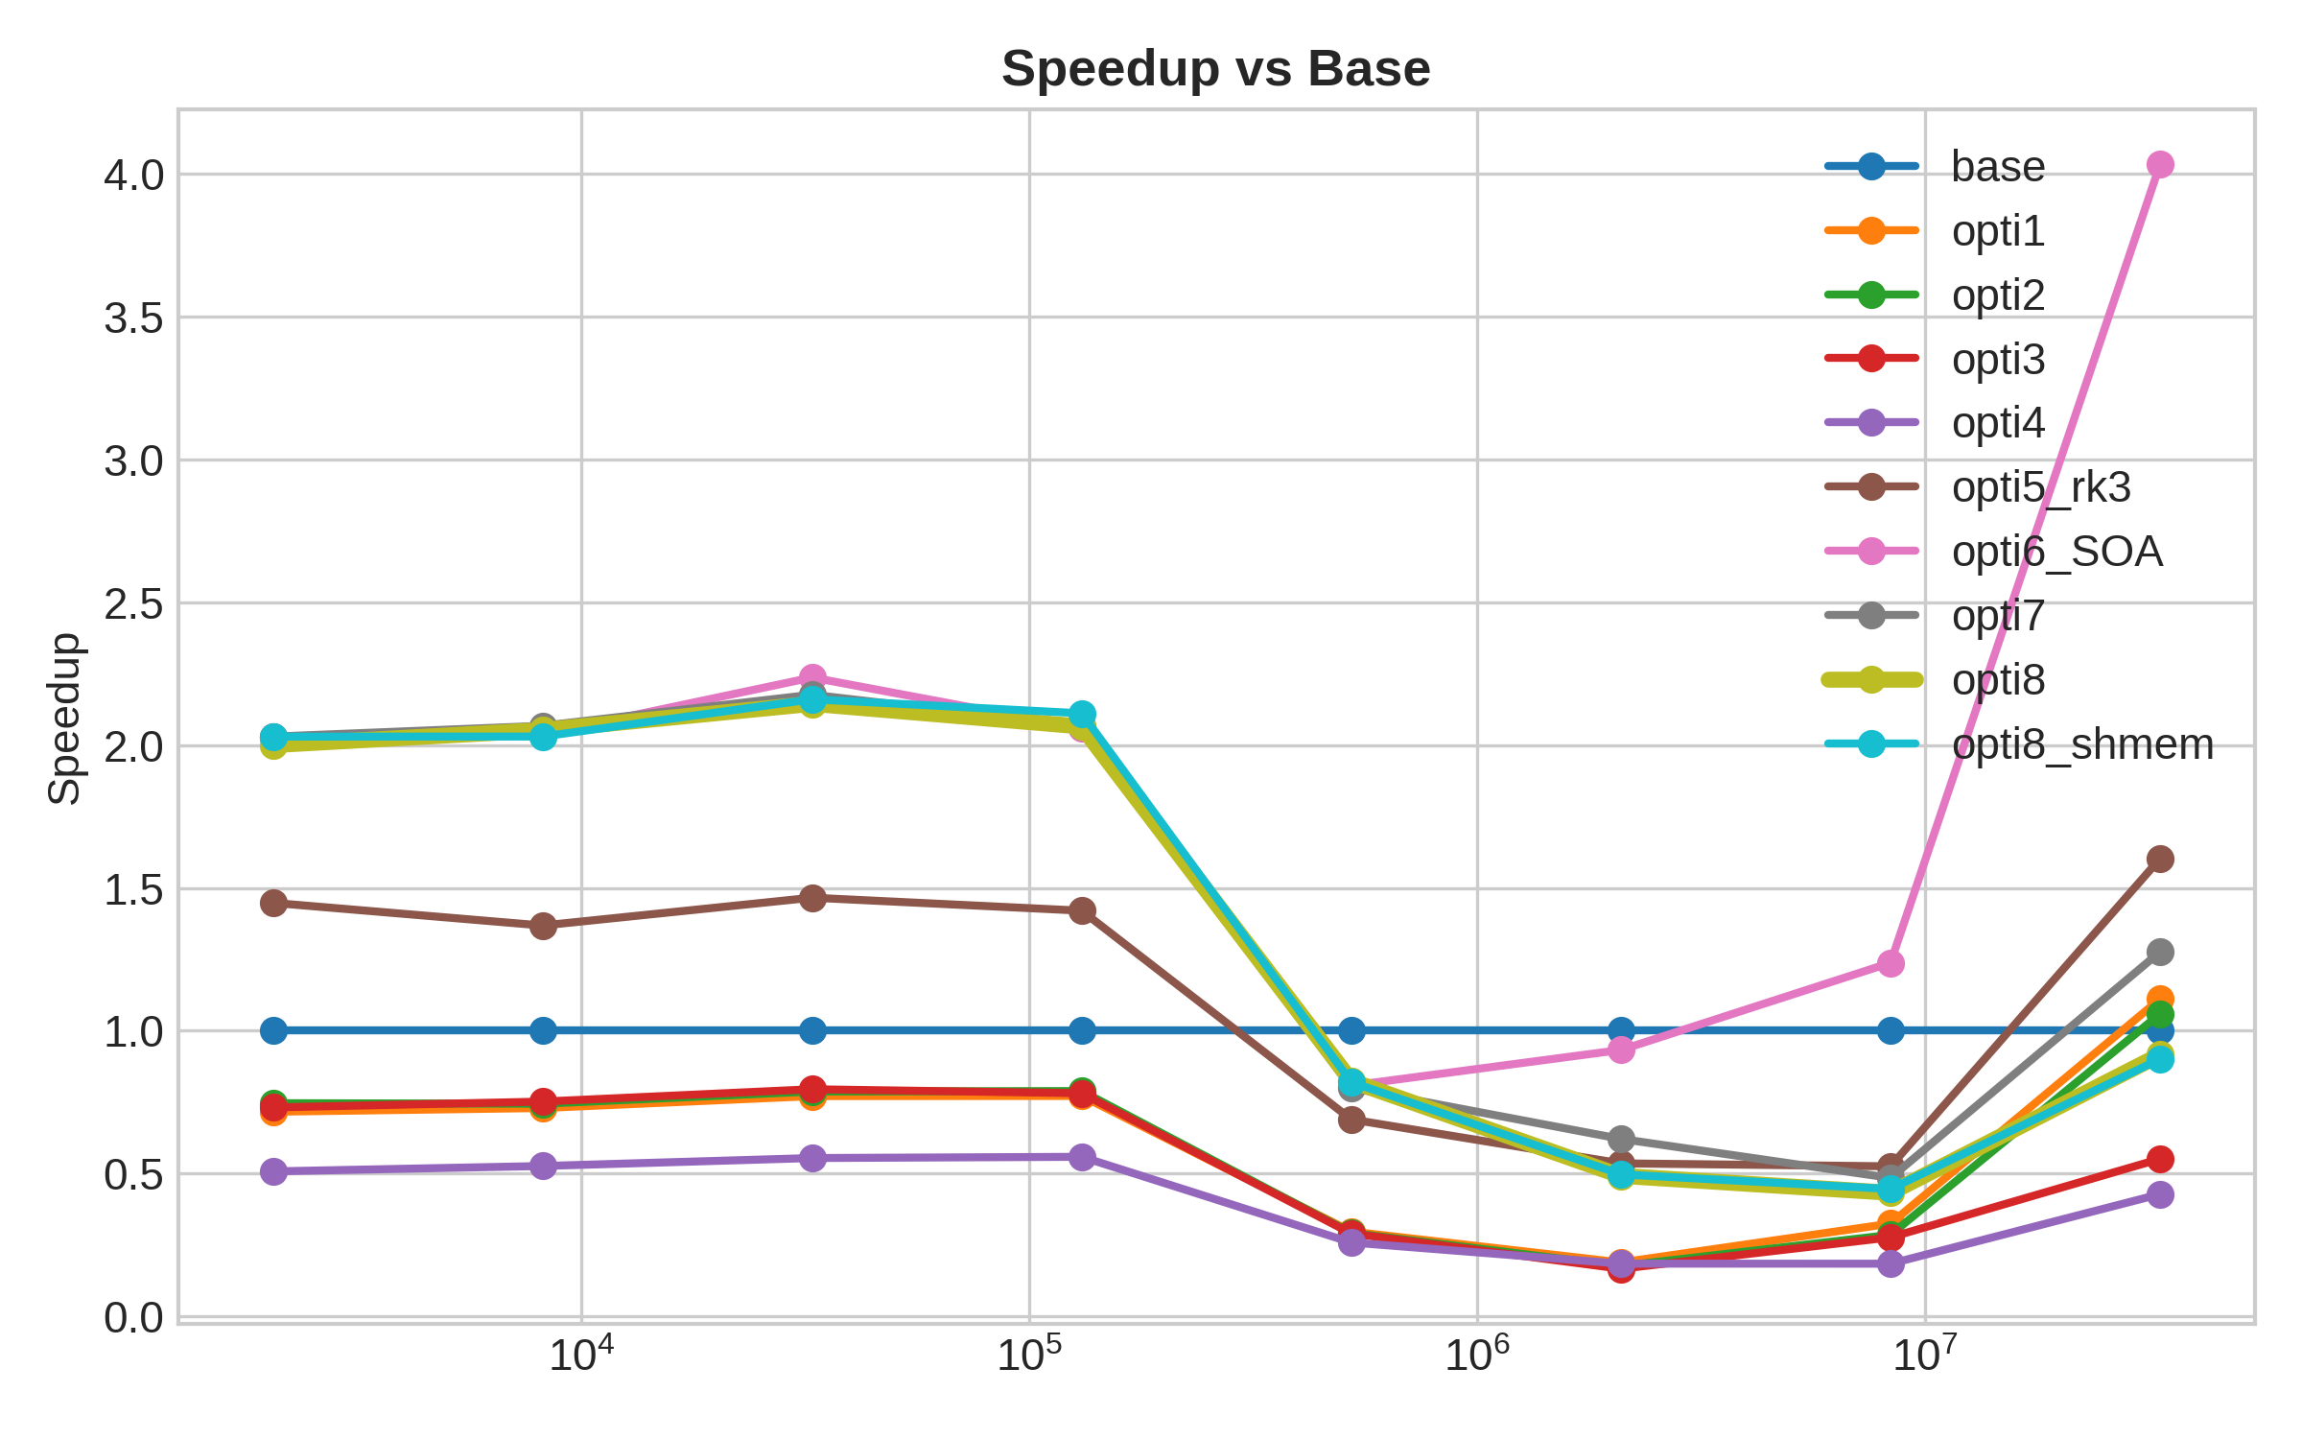
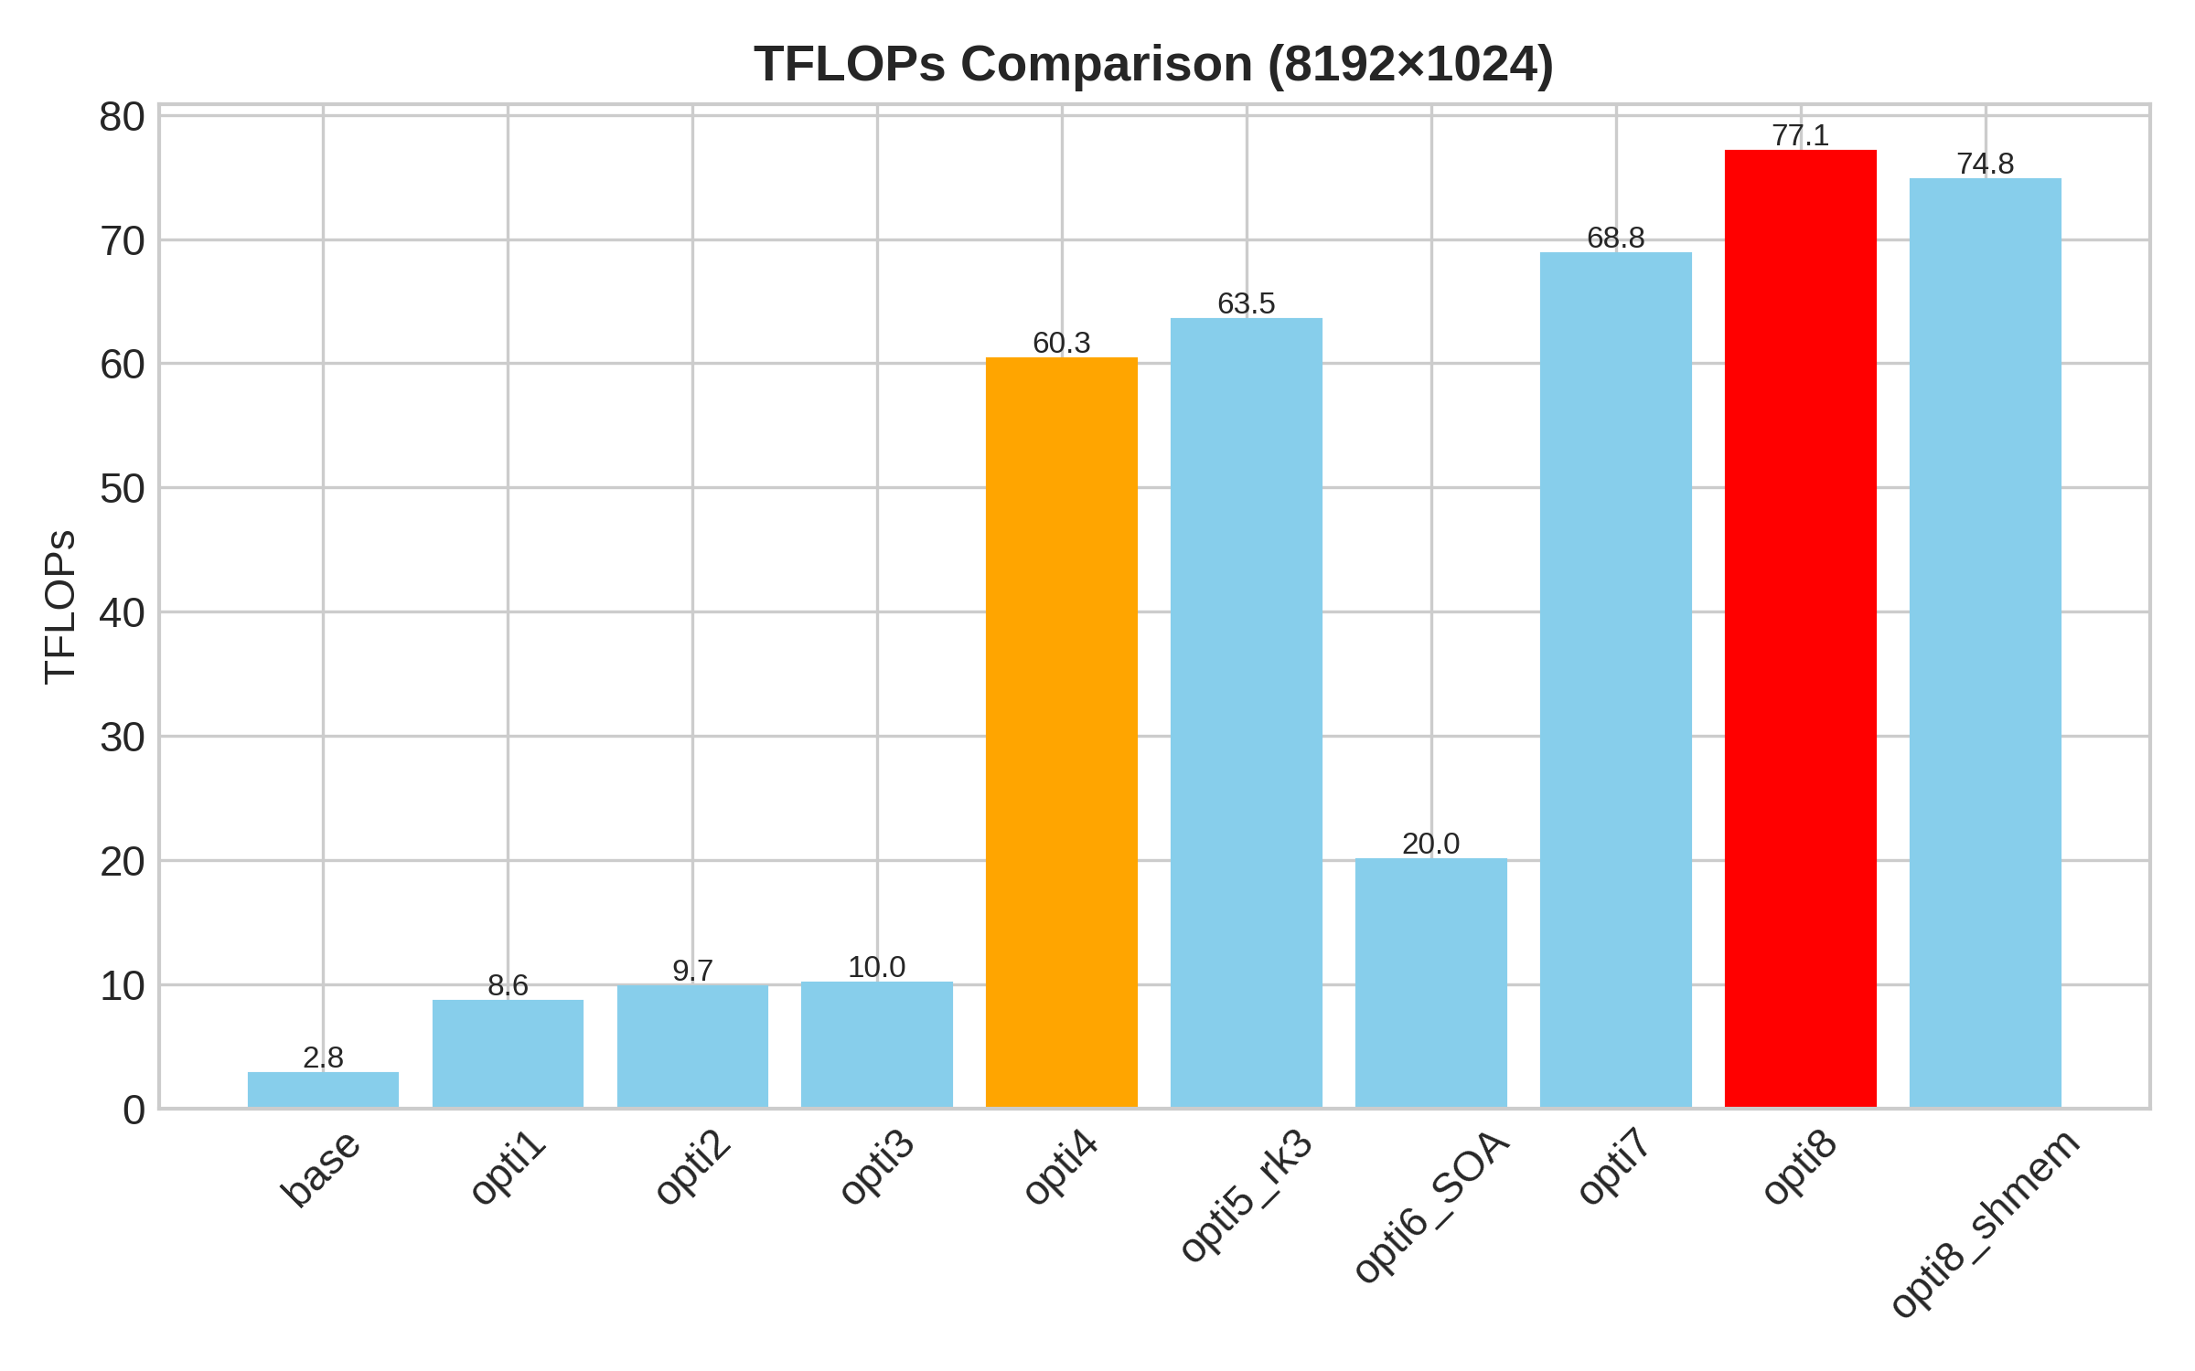
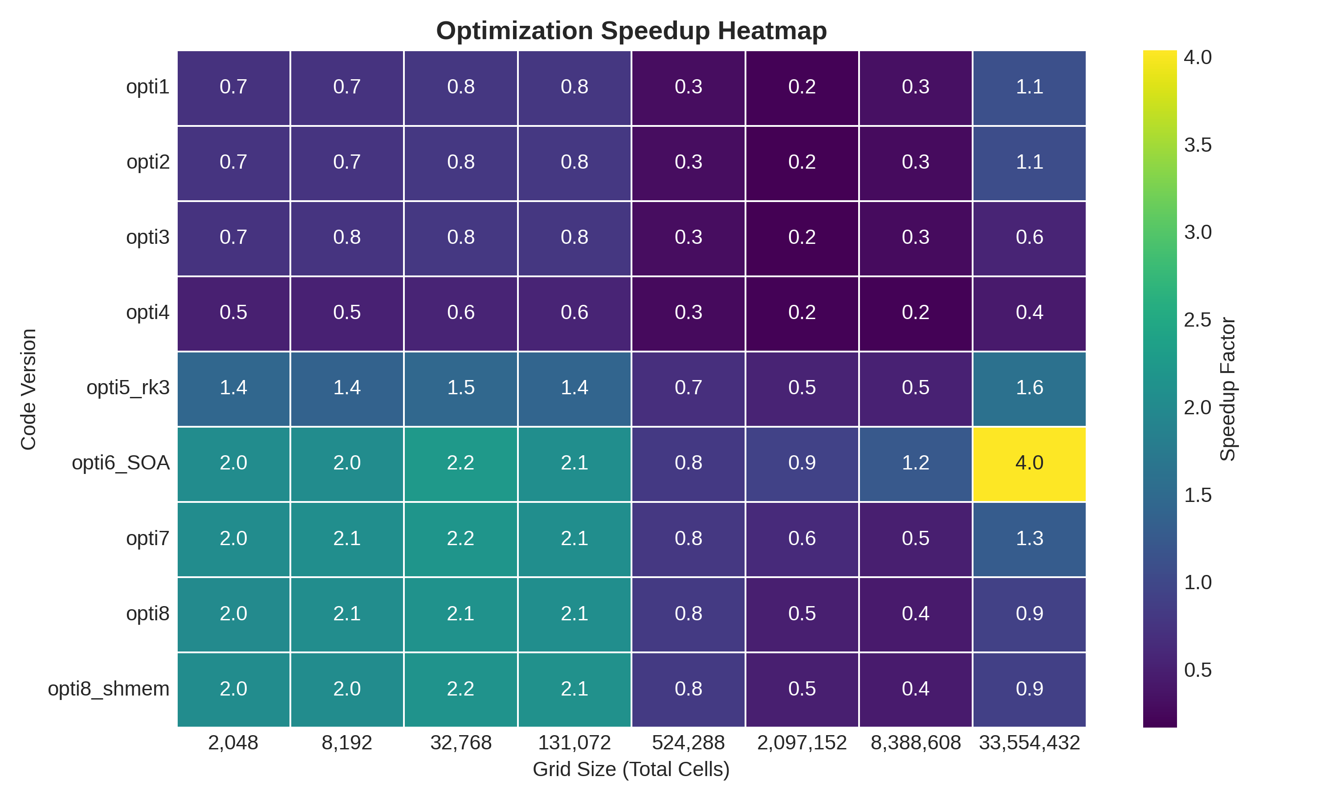
Comparison charts

Slide 13
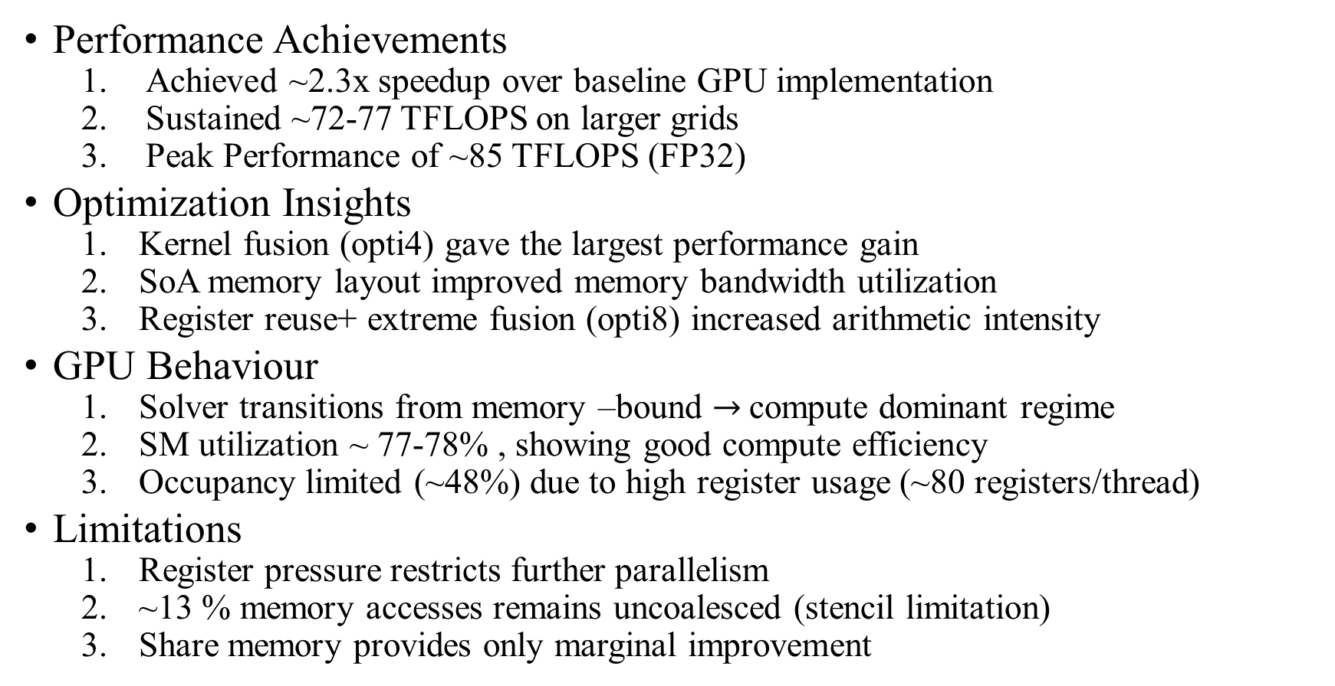
Conclusion
Performance Achievements
Achieved ~2.3x speedup over baseline GPU implementation
Sustained ~72-77 TFLOPS on larger grids
Peak Performance of ~85 TFLOPS (FP32)
Optimization Insights
Kernel fusion (opti4) gave the largest performance gain
SoA memory layout improved memory bandwidth utilization
Register reuse+ extreme fusion (opti8) increased arithmetic intensity
GPU Behaviour
Solver transitions from memory –bound $→$compute dominant regime
SM utilization ~ 77-78% , showing good compute efficiency
Occupancy limited (~48%) due to high register usage (~80 registers/thread)
Limitations
Register pressure restricts further parallelism
~13 % memory accesses remains uncoalesced (stencil limitation)
Share memory provides only marginal improvement

